Slide 1

Churn No More:
Analyzing Customer Churn Using Machine Learning

Slide 2

Department of Statistics
F.YM.Sc Machine Learning Project
Project Mentor- Dr. Suvarna Gopal Ranade
Group Members: Gayatri Ajay Patil:1132232069
Shambhavi Pandey:1132232070

Slide 3
INTRODUCTION
Customer churn refers to the loss of customers or subscribers over time.
High churn rates can lead to revenue loss, increased acquisition costs
Predicting churn helps businesses take proactive actions to retain customers and optimize marketing and sales efforts.

Slide 4
OBJECTIVES
Predict Customer Churn
Identify Churn Drivers
Develop Churn Reduction Strategies
Improve Customer Retention Rate
Visualize Insights and Metrics

Slide 5

DATASET OVERVIEW
Key Features:
Customer Demographics: Includes customer ID, city, zip code, number of dependents, etc.
Service Usage: Phone service, internet type, streaming options, data usage, and technical support.
Tenure: Tenure in months indicating how long the customer has been with the service provider.
Billing Information: Monthly charges, total charges, refunds, and long-distance charges.
Customer Satisfaction & Churn: Includes satisfaction score, churn status, churn score, and churn reason.
Basic Statistics:
Total Customers: 7,043 customers.
Churn Rate: Approx. 26.5% (1,869 out of 7,043 customers).
Churn Categories: Reasons include competitor offers, pricing issues, technical issues, etc.

Slide 6
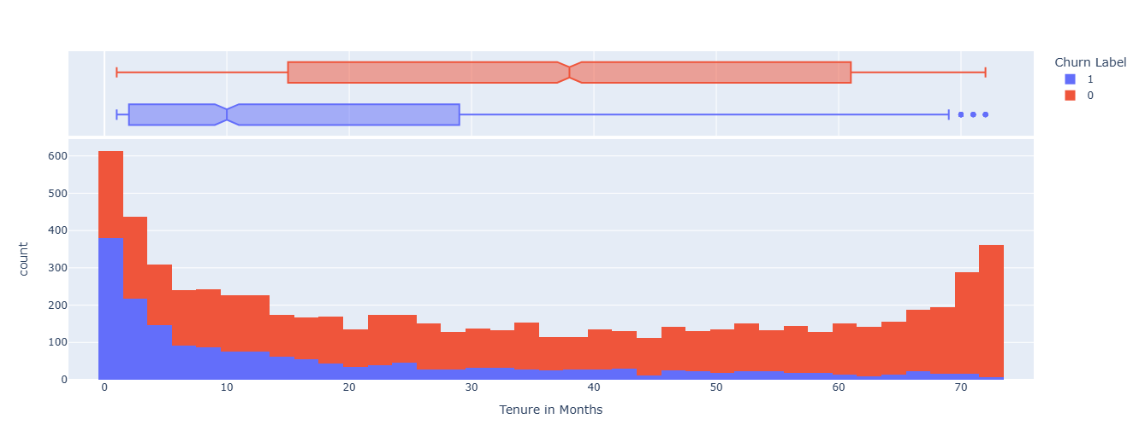
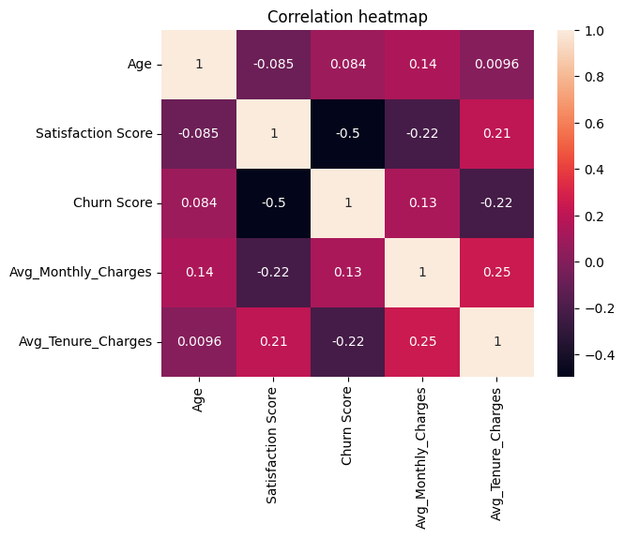
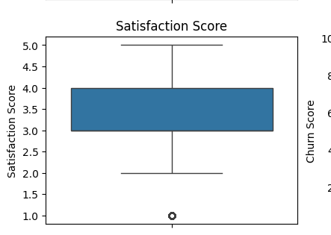
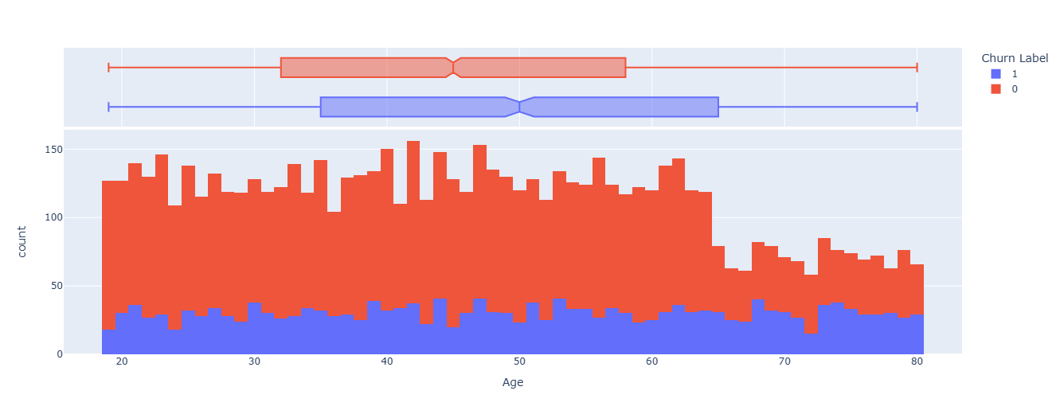
EDA
.
.
.
.

Slide 7
MODEL EVALUATION
Key Aspects | Logistic Regression | Nave Bayes | Support Vector Machines(SVMs) | Decision Tree Classifier
Purpose | To predict the categorical outcomes based on numerical or categorical predictor columns | Used for Text classification and spam filtering ,where features are assumed to be independent | Used for classification and regression ,especially effective in high dimensional spaces and non linear relationships . | A Decision Tree Classifier is used for making predictions by splitting data into branches based on feature values, helping classify data points into predefined categories.
Accuracy | Test Set= 0.71611 Train Set=0.7393 |  | Test set= 0.7161 Train set=0.7393 | Train Set=1.00 Test Set = 0.66
Precision | 0=0.73 1=0.00 | 0=1.00 1=1.00 | 0=0.73 1=0.00 | 0=0.72,1.00 1=0.29,1.00
Recall | 0=1.00 1=0.00 | 0=1.00 1=0.99 | 0=1.00 1=0.00 | 0=86,1.00 1=0.14,1.00
F1-Score | 0=0.84 1=0.00 | 0=1.00 1=0.995 | 0=0.84 1=0.00 | 0=0.78,1.00 1=0.19,1.00
Specificity | 1.00 | 1.0 | 1.00 | 0.861,1.00

Slide 8
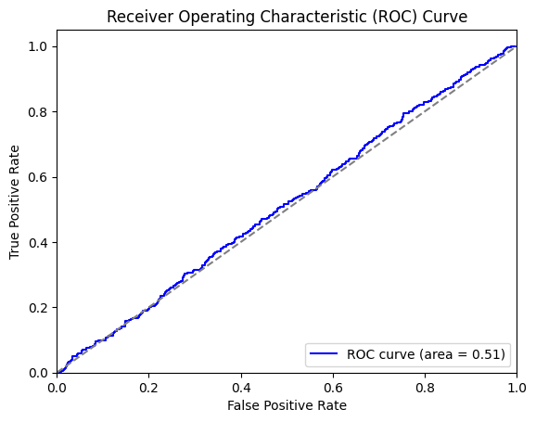
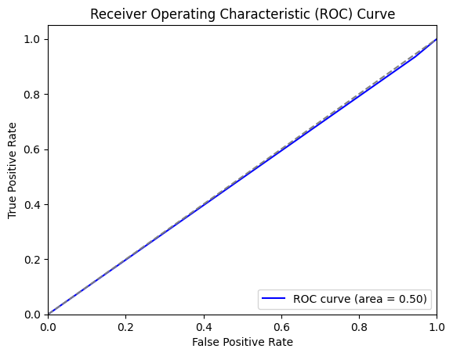
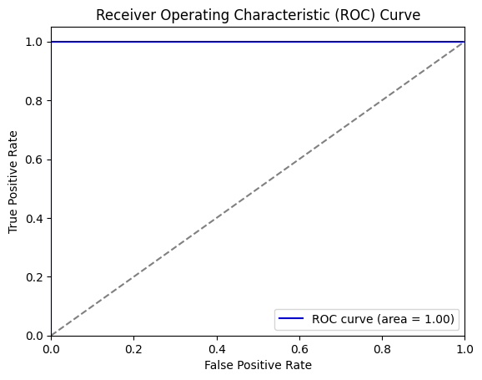
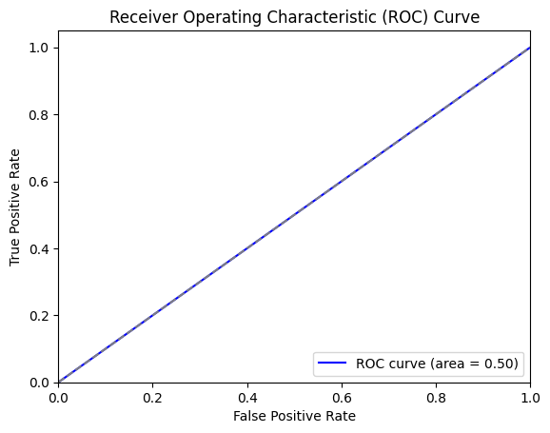
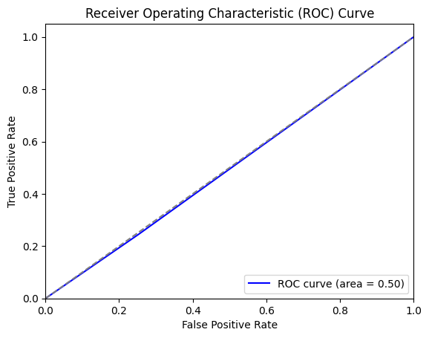


MODEL EVALUATION
ROC-AUC for Logistic Regression=0.5138 | ROC-AUC for Nave Bayes= 0.50
ROC-AUC for SVM= 0.50 | ROC-AUC for Decision Tree=0.50

Slide 9
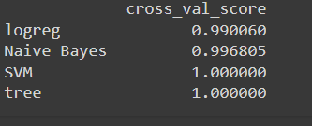
CONCLUSION
Two Best Models:
SVM: Achieved perfect accuracy (1.00), indicating excellent performance.
Decision Tree: Also achieved perfect accuracy (1.00), demonstrating strong performance.
Choosing the Best Model:
SVM might be less computationally efficient for large datasets.
Decision Trees offer better interpretability due to their visual representation.
As all of our model shows high accuracy so we checked the overfitting chances by the Train set, validation set and test set where validation set is a unseen dataset , our model perfomed with accuracy 1 on validation set also .

Slide 10
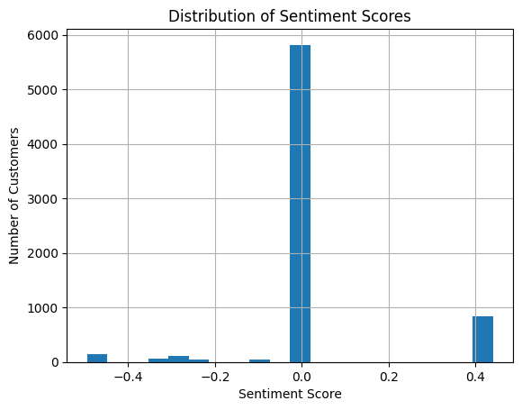
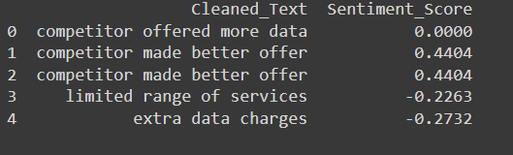
SENTIMENT ANALYSIS
Churned customers exhibited a slightly positive average sentiment score, suggesting that while they had positive experiences, negative sentiment was a contributing factor to their departure.
In contrast, stayed customers demonstrated a neutral average sentiment score, indicating a more balanced experience.
The sentiment score distribution is positively skewed, with a concentration near 0, indicating a generally positive sentiment among customers, although there are some outliers with extreme negative opinions.

Slide 11
THANK YOU

